Slide 1
Using raspberry pi FOR Ham RADIO (Part 2)
By dave slotter, w3djs

Slide 2
W3DJS Raspberry Pi for Ham Radio Image v2.0
Custom-built ham radio software image chock full of applications:
FlDigi Suite | CHIRP | CQRLog
WSJT-X | BlueDV | wsjtx_to_n3fjp
JS8Call | ADS-B Flight Tracker | Pat WinLink + ARDOP
CubicSDR | NOAA Weather Imaging | CW Applications
GQRX | DX Cluster Client + Server | Ham Test Trainers
Direwolf | Xnecview | GPredict
Xastir | YAAC | Support for SDR Hardware
D-Rats | TrustedQSL | …and DOZENS MORE!

Slide 3
How / where can I download the W3DJS Raspberry Pi for Ham Radio v2.0 image?
http://bit.ly/W3DJSRasPiv2img or http://bit.ly/32Xpi74
First image is compressed with BZip and is ~5GB, second is uncompressed and 16GB download
16GB download version available on BitTorrent.
Over 2,000 direct downloads to date!

Slide 4
Where do I get support for W3DJS Raspberry Pi for Ham Radio Image v2.0?
Raspberry-Pi-4-Ham-Radio Forum on Groups.io
https://groups.io/g/RaspberryPi-4-HamRadio/topic/w3djs_raspberry_pi_ham_radio/39671852
QRZ
https://forums.qrz.com/index.php?threads/w3djs-raspberry-pi-ham-radio-image-v2-0-released.680336/
GARS Workshops!

Slide 5
How can I put image on (micro) SD Card?
You just can’t copy the image as a file on to the (micro) SD card.
(some people have tried – and failed)
One solution: dd (for Linux)
But what if I have a Windows PC?
Solution: BalenaEtcher, available at https://www.balena.io/etcher/

Slide 6
What is the initial username and password?
Username: pi
Password: raspberry
Security note: please change the password to something unique, especially if you put your Raspberry Pi on the Internet like me.

Slide 7
How can I change the password?
Quick answer: run “passwd” command from command line / shell
(will need old password to change it, unless you are logged in as root)

Slide 8
How can I change the username “pi”?
YOU DON’T – It causes a huge security risk, according to Kyle, W4KDA.
But you can add a new user to the system!
sudo adduser <username>
Don’t forget to add security groups!
sudo groupmems –group dialout ---add <username>

Slide 9
How can I permanently change the wifi settings?
This one was an error in judging my audience. My bad!
sudo systemctl disable autohotspot.service
sudo nano /etc/dhcpcd.conf
Remove line: “nohook wpa_supplicant”
Reboot, and voila, GUI WiFi interface is now functional!

Slide 10
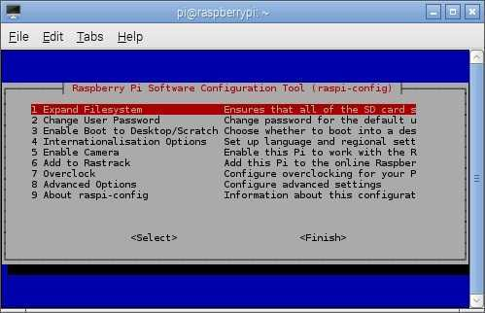
How do I expand the image to use entire (micro) sd card?
You have a 128GB microSD card and the Pi is only using 16GB. What do you do?
This is automatic on Raspbian Buster
On older versions of Raspbian:
sudo raspi-config
Expand Filesystem

Slide 11
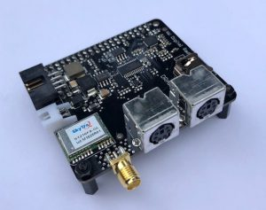
How do I connect the pi to my radio?
Short answer: USB
Cable from RIG
USB Sound Card
SignaLink: $135
Sabrent USB Sound Adapter $7
Another short answer: DRAWS Ham Radio HAT by NW Digital Radio $150

Slide 12
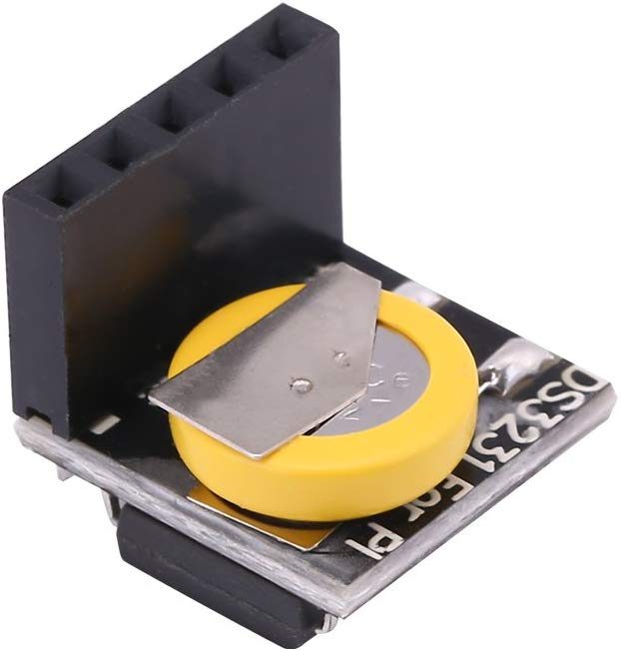
How to keep accurate time on the pi?
In the Hamshack: use timedatectl and NTP
Command: timedatectl
Command: ntpdate –q 0.us.pool.ntp.org
For more info, see https://raspberrytips.com/time-sync-raspberry-pi/
In the Field: use GPS receiver & gpsd
GLONASS GPS Tracker Module for Raspberry Pi: $8
Alternative: RTC Module $15
Alternative: DRAWS Hat GPS Receiver $150

Slide 13
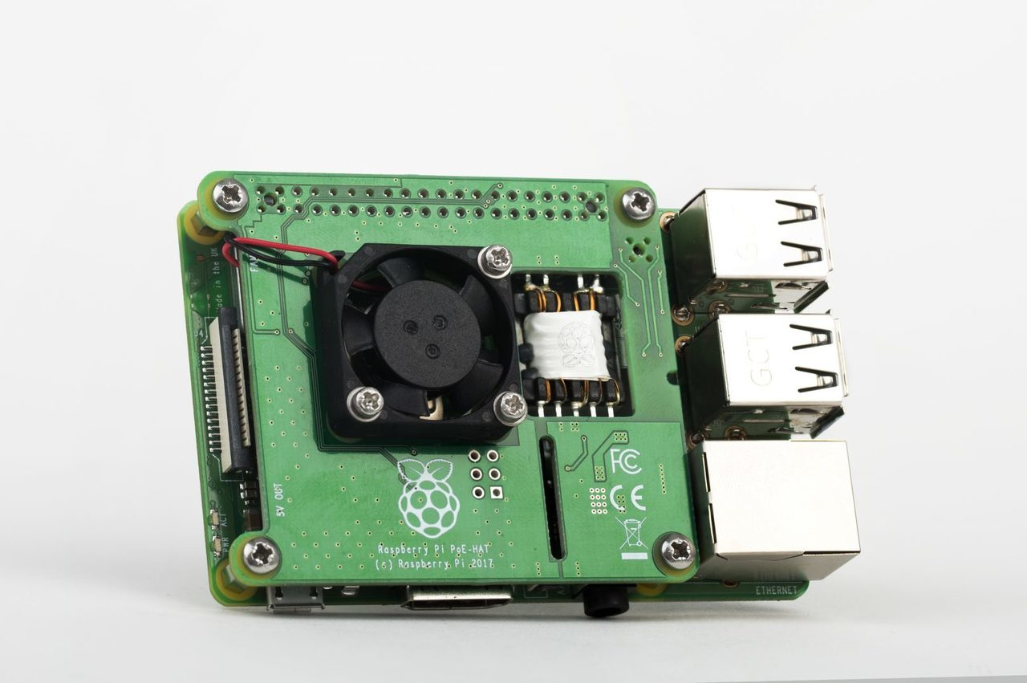
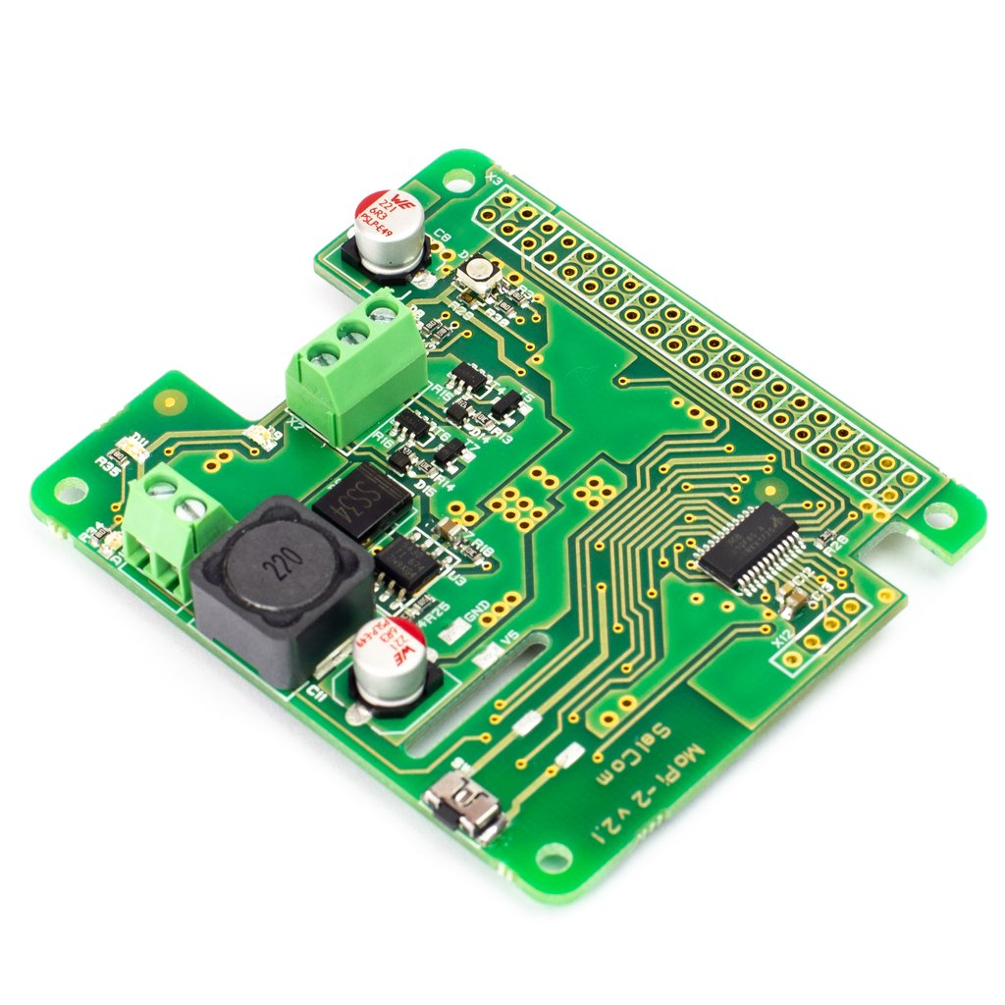
How do I Power My Raspberry Pi?
In the Ham Shack: Power Adapter aka “wall wart”
Also in the Ham Shack: Power over Ethernet (PoE) $20
GPIO Pin #2 (5V) GPIO Pin #6 (GND) Dangerous – only use if you know what you’re doing
Mobile Power – USB Battery Pack $15+
MoPi 2 – Hot-Swap Mobile Power £29
PiJuice Solar Panels

Slide 14
W3DJS Raspberry Pi for Ham Radio Image v2.0 Use Case: Operating Digital Modes
FlDigi Suite by W1HKJ | gnss-sdr - GLONASS satellite system Software Defined Receiver
WSJT-X - Weak Signal (FT8, FT4, etc.) by W1JT | linpsk - amateur radio PSK31/RTTY program via soundcard
GridTracker - Graphical mapping companion program for WSJT-X or JTDX | multimon - multimon - program to decode radio transmissions
JTDX - Alternate client for Weak Signal (FT8, FT4, etc.) | multimon-ng - digital radio transmission decoder
JS8Call - Messaging built on top of FT8 protocol by KN4CRD | psk31lx - a terminal based ncurses program for psk31
JS8CallTools - Get Grid coordinates using GPS | twpsk - a psk program

Slide 15
W3DJS Raspberry Pi for Ham Radio Image v2.0 Use Case: Logging
Software included:
TrustedQSL - LotW client
CQRlog - Ham Radio Logging Application
PyQSO - Logging software (written in Python)
klog - The Ham Radio Logging program
tlf - console based ham radio contest logger
tucnak2 - VHF/UHF/SHF Hamradio contest log version 2
twlog - basic logging program for ham radio
wsjtx_to_n3fjp - Logging adapter to allow WSJT-X to log to N3FJP by yours truly, W3DJS
xlog - GTK+ Logging program for Hamradio Operators

Slide 16
W3DJS Raspberry Pi for Ham Radio Image v2.0 Use Case: APRS
Software included:
Direwolf - Software "soundcard" AX.25 packet modem/TNC and APRS encoder/decoder
Xastir - APRS GUI client / Digipeater / Igate
YAAC - Yet Another APRS Client
APRS Message App for JS8Call
aprsdigi - digipeater for APRS
aprx - APRS Digipeater and iGate
soundmodem - Sound Card Amateur Packet Radio Modems

Slide 17
W3DJS Raspberry Pi for Ham Radio Image v2.0 Use Case: CW / Morse Code
aldo - Morse code training program | morse - training program about morse-code for aspiring radio hams
cw - sound characters as Morse code on the soundcard or console speaker | morse2ascii - tool for decoding the morse codes from a PCM WAV file
cwcp - Text based Morse tutor program | morsegen - convert file to ASCII morse code
xcwcp - Graphical Morse tutor program | qrq - High speed Morse telegraphy trainer
cwdaemon - morse daemon for the serial or parallel port | twcw - sends morse code via the sound card or serial card (Needs RTC installed)
ebook2cw - convert ebooks to Morse MP3s/OGGs | xdemorse - decode Morse signals to text
ebook2cwgui - GUI for ebook2cw | rscw - Receive CW through Soundcard

Slide 18
W3DJS Raspberry Pi for Ham Radio Image v2.0 Use Case: D-Star
Software included:
d-rats - A communication tool for D-STAR
BlueDV - Client for D-Star and DMR (Phone)

Slide 19
W3DJS Raspberry Pi for Ham Radio Image v2.0 Use Case: Software Defined Radio (SDR)
CubicSDR - Software Defined Radio receiver | SoapyMultiSDR - Multi-device support module for SoapySDR
cutesdr - Simple demodulation and spectrum display program | SoapyNetSDR - Soapy SDR module for NetSDR protocol
GQRX - Software defined radio receiver | SoapyRemote - Use any Soapy SDR remotely
SDRAngel - SDR player | SoapyRTLSDR - Soapy SDR module for RTL SDR USB dongle
lysdr - Simple software-defined radio | SoapySDR - Vendor and platform neutral SDR support library
quisk - Software Defined Radio (SDR) | SoapySDRPlay - Soapy SDR module for SDRPlay
SoapyAudio - Soapy SDR plugin for Audio devices
SoapyHackRF - SoapySDR HackRF module | (More SDR HW to be supported in v3 image)

Slide 20
W3DJS Raspberry Pi for Ham Radio Image v2.0 Use Case: Satellite Communication
Software included:
Gpredict - Satellite prediction
predict-gsat - Graphical Predict client
gnss-sdr - GLONASS satellite system Software Defined Receiver
wxtoimg - NOAA weather imaging software

Slide 21
W3DJS Raspberry Pi for Ham Radio Image v2.0 Use Case: WinLink / EmComm
Software included:
Pat WinLink - WinLink for Raspberry Pi (and other platforms)
ARDOP support for Pat WinLink
ARDOP-GUI - Provides graphical representation of ARDOP connections
Find ARDOP - Retrieves local ARDOP sources by KM4ACK
AX25 support for Pat WinLink
PMON - a PACTOR® Monitoring Utility for Linux

Slide 22
W3DJS Raspberry Pi for Ham Radio Image v2.0 Use Case: Antenna Modeling
Software included:
antennavis - Antenna Visualization Software
gsmc - A GTK Smith Chart Calculator for RF impedance matching
nec2c - Translation of the NEC2 FORTRAN source code to the C language
xnecview - NEC structure and gain pattern viewer
yagiuda - software to analyse performance of Yagi-Uda antennas
VOACAP - HF propagation prediction

Slide 23
W3DJS Raspberry Pi for Ham Radio Image v2.0 Use Case: Ham Training / Testing
Software included:
fccexam - Study tool for USA FCC commercial radio license exams.
hamexam - Study guide for USA FCC amateur radio (ham radio) license examinations.

Slide 24
W3DJS Raspberry Pi for Ham Radio Image v2.0 Use Case: Miscellaneous Applications
Software included:
CHIRP - Radio Programming Software
QTel - EchoLink client
QSSTV - Slow Scan TV (e.g. "Fax")
FreeDV - Free digital voice vocoder
WsprryPi - WSPR software
ADS-B Flight Tracking Software
Xdx is a DX-cluster client
DXSpider - DX Cluster Server

Slide 25
The W3DJS Raspberry Pi Image V2.0 Supports
The Father’s Rights Movement – 50/50 Shared Parenting

